Slide 1
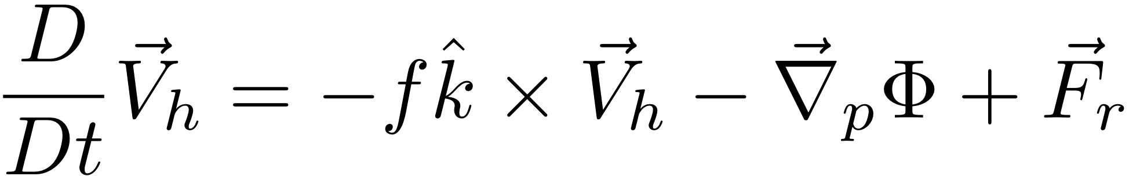
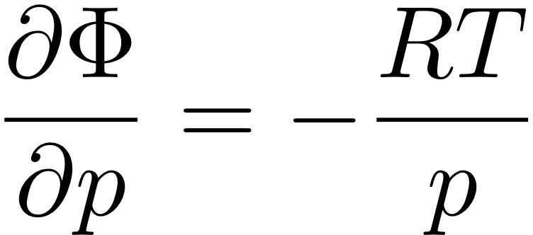


“The Primitive Equations”
(meaning elemental, fundamental)
F=MA in the HORIZONTAL
HYDROSTATIC (w/ ideal gas law to eliminate ρ)
MASS CONSERVATION
FIRST LAW OF THERMO
Notes:
\frac{D}{Dt} \vec V_h = -f \hat k \times \vec V_h - \vec \nabla_p \phi +\vec F_r
\frac {\partial \Phi}{\partial p} = - \alpha \equiv -\frac{1}{\rho}
\alpha = \frac{RT}{p}
\frac {\partial u}{\partial x} + \frac {\partial v}{\partial y} + \frac {\partial \omega}{\partial p} = 0
\frac {D_hT}{Dt} + S_p \omega = J/C_p

Slide 2
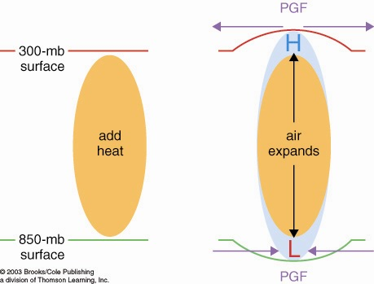
How heated air rises and a warm core vortex develops: the Primitive Equation view. 7 logical steps
1. Warmed column of air gets thicker
2. Air accelerates
due to PGF
2. Air accelerates
due to PGF
1. 200 mb
surface
bulges
upward
0. Heating (maybe latent heating by condensation in a patch
of convection over warm water someplace)

Slide 3
How heated air rises and a warm core vortex develops: the Primitive Equation view. 7 logical steps
3. Mass removal and 4. surface pressure drop
3. Mass removed
from column
3. Mass removed
from column
4. less mass of air in column
= lower surface pressure
L

Slide 4
How heated air rises and a warm core vortex develops: the Primitive Equation view. 7 logical steps
5. Low level inflow accelerates, 6. heated air rises
6. warm
air
rises!
5. Air accelerates
due to PGF
5. Air accelerates
due to PGF

Slide 5
How heated air rises and a warm core vortex develops: the Primitive Equation view. 7 logical steps
ANTI
CYCLONIC
Warm
Core
Vortex
CYCLONIC
FLOW
7. Coriolis turns flow to right

Slide 6
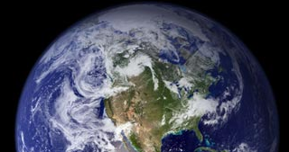
How cooled air sinks and a cool core vortex develops:
the Primitive Equation view. 7 logical steps
1. Cooled column of air gets thinner
2. Air accelerates
due to PGF
2. Air accelerates
due to PGF
200 mb
surface
IR cooling
cold
air
1. 200 mb
surface
bulges
downward

Slide 7
How cooled air sinks and a cool core vortex develops:
the Primitive Equation view. 7 logical steps
3. Mass drawn in
to column
3. Mass drawn in
to column
L
4. more mass of air in column
= higher surface pressure
H

Slide 8
How cooled air sinks and a cool core vortex develops:
the Primitive Equation view. 7 logical steps
L
6. Cold air sinks
5. Air accelerates
due to PGF
5. Air accelerates
due to PGF
H

Slide 9
How cooled air sinks and a cool core vortex develops:
7. Coriolis force turns the winds
L
CYCLONIC
FLOW
Cool
core
Vortex
ANTI
H
CYCLONIC

Slide 10
The geostrophically balanced polar vortex:
The Coriolis force on the westerly jet stream
prevents cold pool of Arctic air from sinking down
and covering the whole Northern Hemisphere
L
Cor.
PGF
PGF
Cor
Heavy cold air
would like to sink
if it could
H

Slide 11
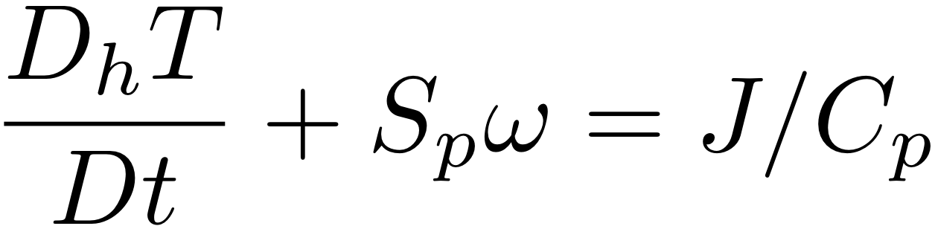
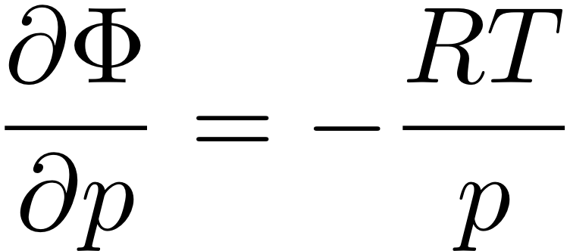
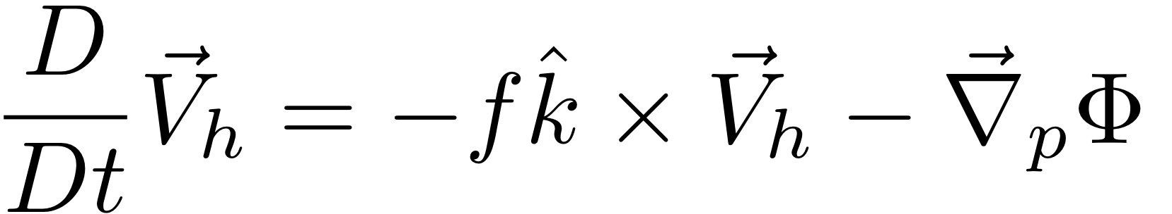
HW: use The Primitive Equations to compute how a local heating J drives flow in an initially motionless atmosphere
J causes T to increase
net change of T =
amount of heat added/Cp
2. Warmer T causes increased thickness of the heated column
3. High Φ over hot column pushes wind outward
4. Surface pressure drops (remember, omega = Dp/Dt; Holton eq. 3.44)
Notes:
Homework 5, MSC 405. Due Thursday, April 13
This problem set walks through the heated-air-rising process above, for a 100 km patch of latent heating in an initially motionless atmosphere.
ALL ANSWERS MUST HAVE UNITS, BUT NUMBERS CAN BE SIMPLE ROUGH ESTIMATES.
Suppose the heating J corresponds to the latent heat released during 1cm of rain over a 100km x 100km area. Let’s figure out how much ΔT that causes.
What is the volume of water condensed (m³)?
What is the mass of water condensed (kg)?
How much latent heat is released (Joules)? (L = 2.5 x 10⁶ J per kg of water).
How many kg of air are in a 1 square meter column of atmosphere, if surface pressure p is 1000mb? M=p/g
How many kg of air are therefore in a 100km x 100km column?
If Cp = 1000 J/(kg K), by how many K can the heat from c. warm the air mass from e.?

Slide 12
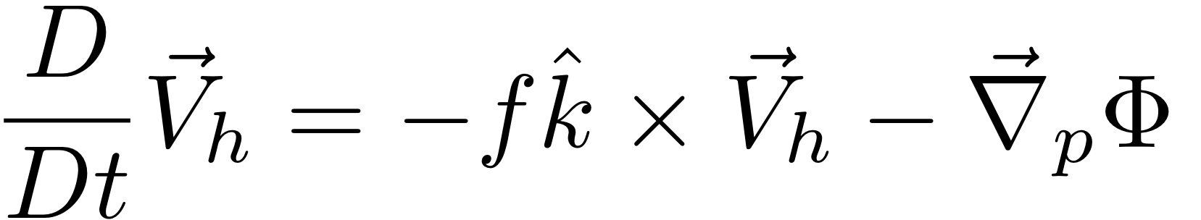
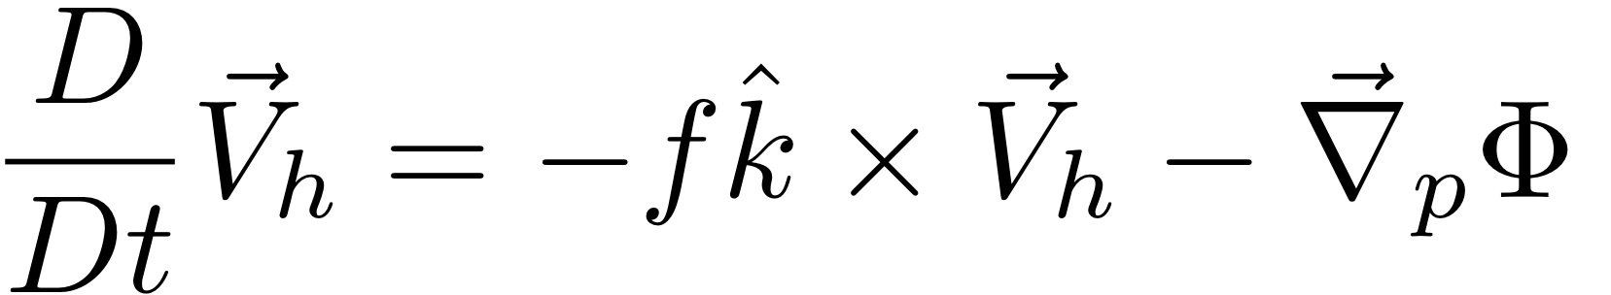
HW: use The Primitive Equations to compute how a local heating J drives flow in an initially motionless atmosphere
5. Low Φ under hot column pulls wind inward
6. Hot air rises (finally!)
ω =~ ρgw
7. Coriolis force turns inflowing and outflowing air to make round-and-round flow
Notes:
Homework 5, MSC 405. Due Thursday, April 12
This problem set walks through the sequential process above, for a 100 km patch of latent heating in an initially motionless atmosphere.
ALL ANSWERS MUST HAVE UNITS, BUT NUMBERS SHOULD BE ROUGH: 1-2 SIGNIFICANT DIGITS.
Suppose the heating J corresponds to the latent heat released during 1cm of rain over a 100km x 100km area. Let’s figure out how much ΔT that causes.
What is the volume of water condensed (m³)? (1 point)
What is the mass of water condensed (kg)? (1 point)
How much latent heat is released (Joules)? (1pt) (L = 2.5 x 10⁶ J per kg of water).
How many kg of air are in a 1 square meter column of atmosphere, if surface pressure p is 1000mb? M=p/g (1)
How many kg of air are therefore in a 100km x 100km column? (1)
If Cp = 1000 J/(kg K), by how many K can the heat from c. warm the air mass from e.? (1)

Slide 13
The atmosphere is thin, so a lot of its flow is horizontal large scale circulations. Can’t we study the dynamics of that without getting sucked into thermodynamics?
If only we could clobber the “gradient of Φ” term...
that way lies vorticity as we have seen!
F=MA in the HORIZONTAL
HYDROSTATIC (w/ ideal gas law)
MASS CONSERVATION
FIRST LAW OF THERMO
Notes:
\frac{D}{Dt} \vec V_h = -f \hat k \times \vec V_h - \vec \nabla_p \phi +\vec F_r
\frac {\partial \Phi}{\partial p} = - \alpha \equiv -\frac{1}{\rho}
\alpha = \frac{RT}{p}
\frac {\partial u}{\partial x} + \frac {\partial v}{\partial y} + \frac {\partial \omega}{\partial p} = 0
\frac {D_hT}{Dt} + S_p \omega = J/C_p

